Slide 2
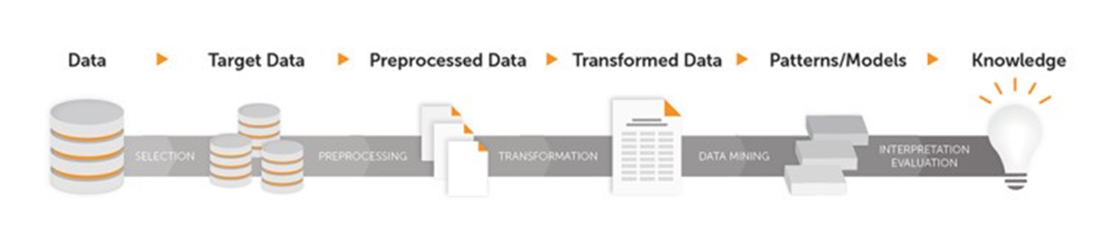
Data Science Procedure
Step 1: | Data Capture & Collection – Data sourcing, integration
Step 2: | Data Visualization/Exploration – Preliminary insight
Step 3: | Data Preparation– Clean/transform
Step 4: | Data Analysis (Modeling) –Apply ML & AI models
Step 5: | Model Evaluation- Evaluate accuracy of model
Step 6: | Predict/Deploy – Apply actionable intelligence gained from the analysis

Slide 3
Machine Learning Techniques
Regression
Predictive (Supervised Learning)
Classification
Machine Learning
Time Series
Association Rule
Descriptive (Unsupervised Learning)
Clustering

Slide 4
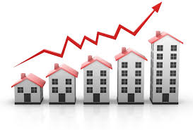
Supervised ML: Example of House Price Prediction
Training Data Set
Independent Variables Target ( Label)
Test Data Set
Independent Variables Target ( Label)
Sq. feet | Bedroom | Lot size, acre | Pool | Neighborhood | Price
5000 | 5 | 1.2 | Yes | 1 | 350,000
3200 | 3 | 0.6 | No | 4 | 285,000
4600 | 4 | 0.9 | Yes | 2 | 495,000
2500 | 3 | 0.4 | No | 4 | 250,000
5200 | 5 | 1 | Yes | 3 | 525,000
3300 | 4 | 0.8 | Yes | 5 | 340,000
Sq. feet | Bedroom | Lot size, acre | Pool | Neighborhood | Price
3400 | 3 | 0.75 | No | 1 | ????
4900 | 3 | 0.9 | Yes | 2 | ????
Notes:
Data Set: a collection of data with defined structure. This table is a data set with defined structure of 7 rows and 6 columns including column headers.
A record (datapoint) is a single instance in the dataset. Each row in the above table is a record. Each instance has the same structure as the dataset.
An attribute (variable, feature) is a single property of dataset. Each column in the above table is an attribute. Attributes can be numeric, categorical, date-time, or Boolean data types.
A label is a special attribute that needs to be predicted based on all input attributes. In above table, price is the output attribute.
Identifiers are special attributes that provide context to individual records. Names, account numbers, customer id are examples of identifiers.

Slide 5
Supervised ML
Mathematically models the relationships between explanatory variables and the target variables. The models are then used to make predictions on previously unseen new data
Can have complex multivariate and non-linear relationships.
Important Terms:
X = explanatory variable (a.k.a., independent variable)
Univariate (Only one independent variable, X), Ex: Sq. Footage
Multivariate (Many independent variables, X1, X2, X3, X4), Ex: Sq. Footage, Lot size, # of bedrooms
Y = outcome variable (a.k.a., dependent variable). Ex: Home Price
Fit = how well a model captures the relationship between input and target variables.
Y ~ f(X)

Slide 6
Train | Validate | Test
Original Dataset
Train ~80%
Test ~20%
Train ~60%
Validate ~20%
Test ~20%

Slide 7
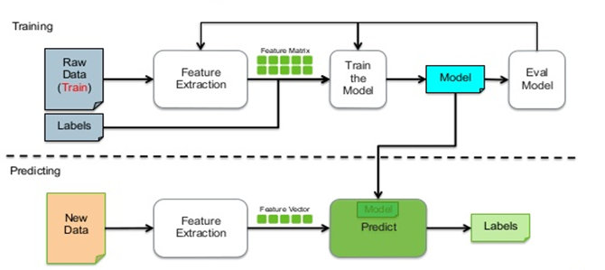
Putting It All Together

Slide 8
Supervised ML Techniques
Regression
Classification
Time Series Analysis

Slide 9

Regression

Slide 10
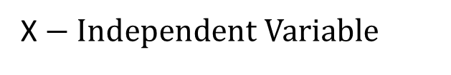

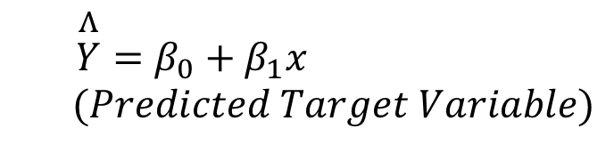
Linear Regression
In Regression, the goal is to predict a target variable which is continuous
Practical Housing Example: Predicting House Prices
R² = 0 (No improvement over Base Model
R² = 1 (Perfect Model and Fit)
Notes:
Assumptions:
Data is Linear
No multicollinearity
Error term has constant variance

Slide 11
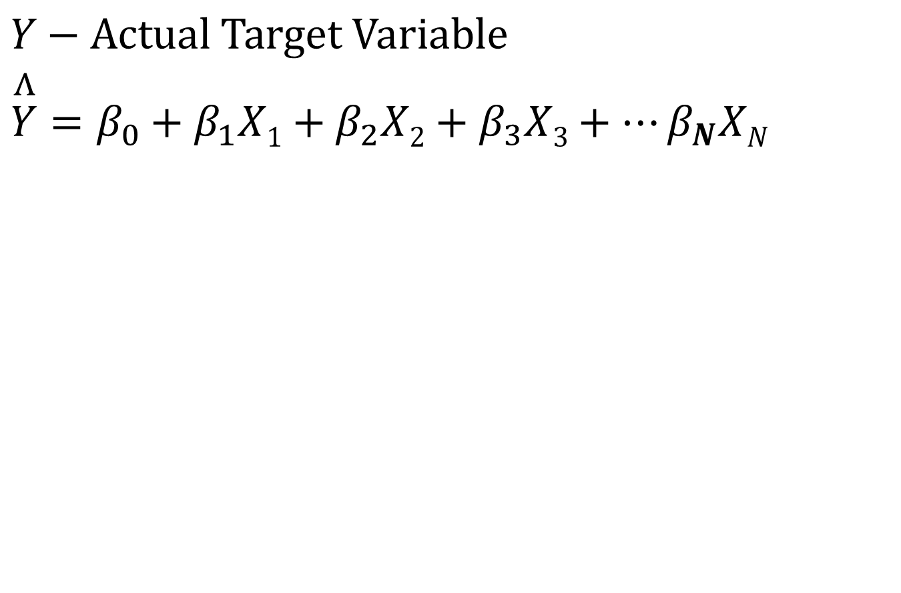
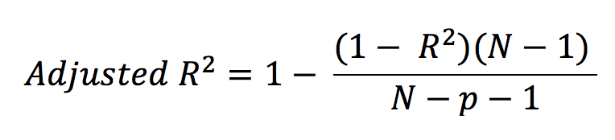
Multivariate Regression
X1: Sq. footage
X2: Bed rooms
X3: Lot size
….
XN: Crime rate

Slide 12
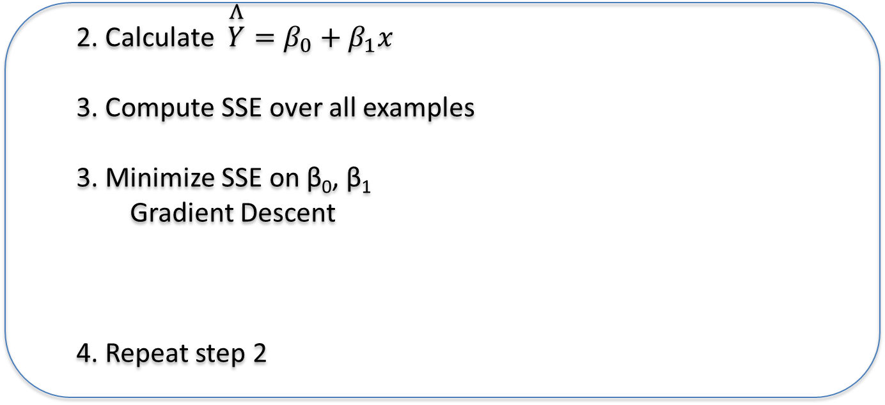
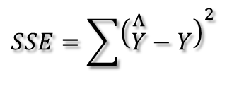
Algorithm
Initialize
Loop over some iterations or until SSE is minimized

Slide 13
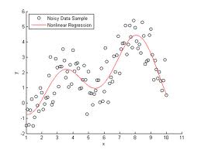
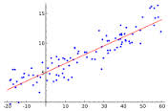
Regression Algorithms
Depending on the data distribution, regression models can be divided into two classes:
Linear Regression: data is modeled using linear functions
Nonlinear Regression: data is modeled using nonlinear functions
Linear Regression
Non linear regression

Slide 14
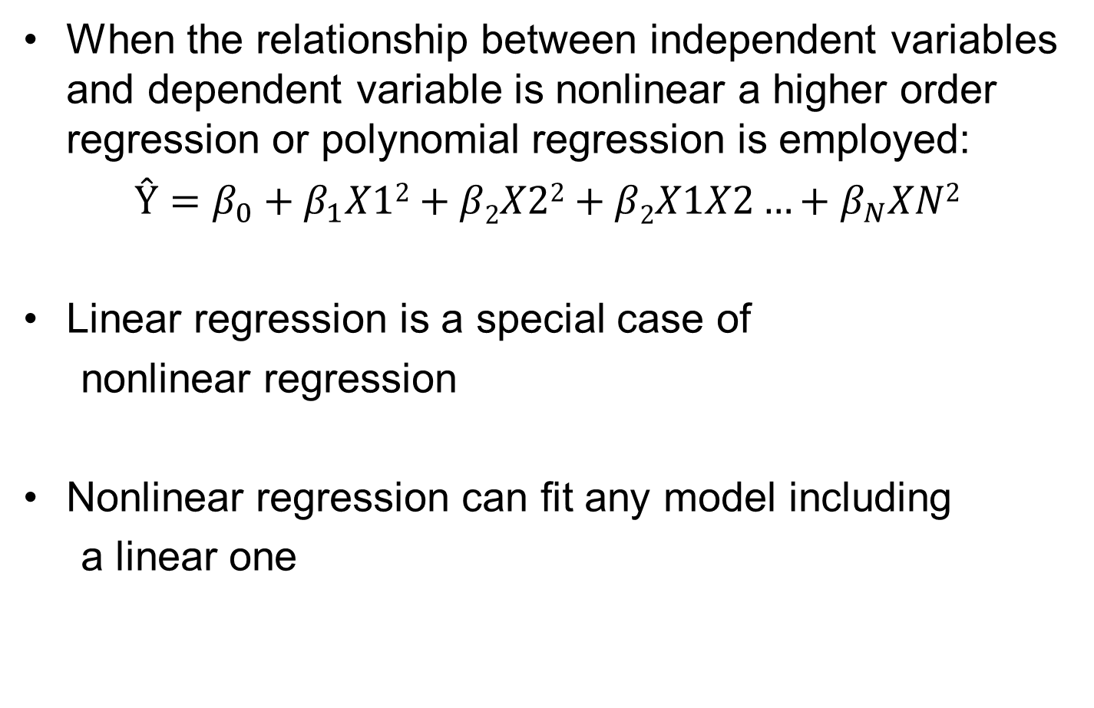
Nonlinear Regression
When the relationship between independent variables and dependent variable is nonlinear a higher order regression or polynomial regression is employed:
$$Ŷ=β_{0}+β_{1}X12+β2X22+β2X1X2…+β_{N}XN2$$
Linear regression is a special case of
nonlinear regression
Nonlinear regression can fit any model including
a linear one

Slide 15
Classification

Slide 16


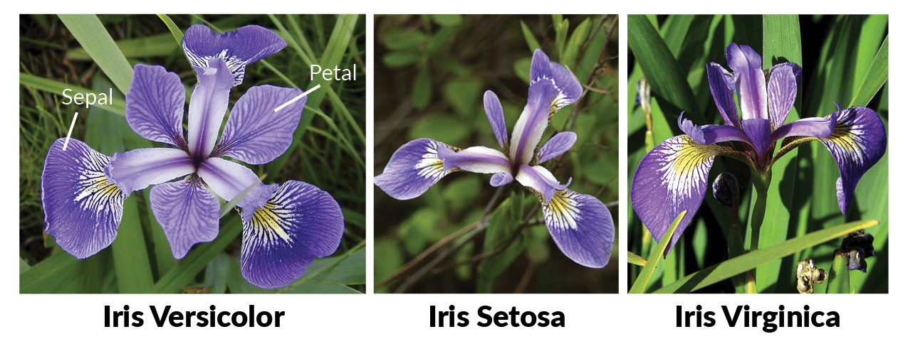
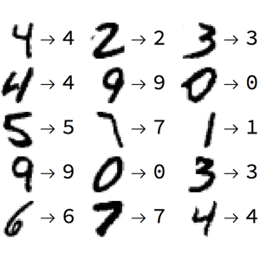
Classification
Goal is to predict a ‘label’ or (‘target variable’) which is discrete (not continuous)
Types of Classification
Binary Classification
Pass/fail
Yes/no
Customer selects a product or not
Disease or no disease
Multiclass classification
Identify types of flowers
Digits recognition
Predicting wine types
Classify several diseases

Slide 17
Classification Algorithms
There are a number of ML classification algorithms:
Classification
Logistic Regression
Decision Trees
Knn (k-nearest neighbors)
Naïve-Bayes
Support Vector Machines
Neural Networks
Random Forest

Slide 18
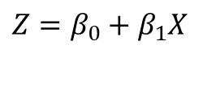
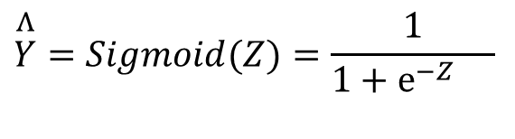
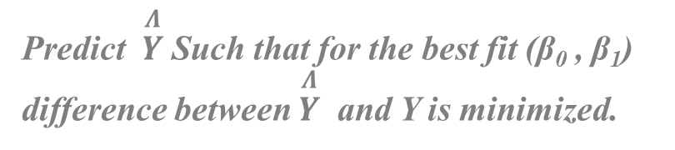


Classification: Logistic Regression
Ex: Predicting if a website link is Phishing or not
Y = 1 (Phishing ), Y = 0 (Normal)
If Sigmoid(Z )> 0.5, Predict
If Sigmoid(Z) < 0.5, Predict

Slide 19

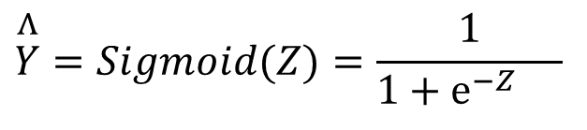

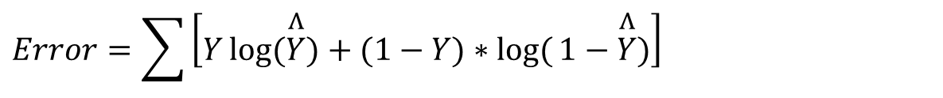
Algorithm
Initialize
Loop over some iterations or until Error is Minimized
$$β_{0},β_{1}$$
2. Compute
3. Calculate Error
4. Minimize Error (Gradient Descent)
5. Repeat from step 2
$$Z=β_{0}+β_{1}x ,$$
$$\overset{Λ}{Y}=Sigmoid(Z)=\frac{1}{1+e^{−Z}{}}$$
$$Error=\sum{\left[Y\log{(\overset{Λ}{Y}})+(1−Y)∗\log{(}1−\overset{Λ}{Y})\right]}$$

Slide 20
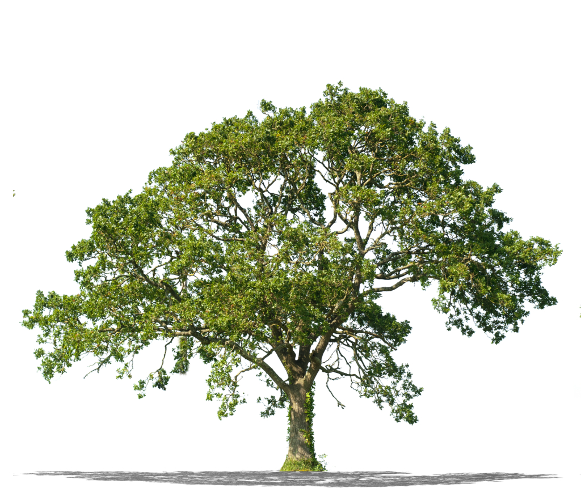
Classification: Decision Trees
A tree is built by splitting the data into subsets based on an attribute value test.
This splitting process is then repeated on each subset in a process called recursive partitioning.
This process of top-down induction of decision trees is an example of a greedy algorithm
The process stops when the splitting no longer adds value to the predictions.
Notes:
Greedy algorithm: Algorithm greedily searches for an optimum split at the top level. Then repeats the process at each level. It does not check whether or not split will lead to the lowest possible impurity several levels down.A greedy algorithm often produces a reasonably good solution, but it is not guaranteed to be optimal solution.

Slide 21
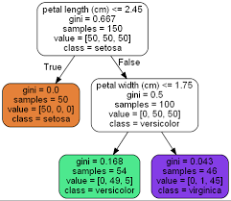
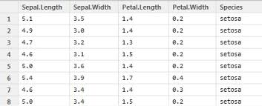
Decision Trees
Practical Example: Classification of Iris Flowers
Notes:
How did it choose petal length and 2.45. It searchers for the (feature, threshold) pair that produces the purest subsets (weighted by their size).
J((feature, threshold) = (mleft/m)*gleft + (mright/m)

Slide 22
Decision Trees
An intuitive, easy to interpret data mining technique that can be mapped to “if then” business rules.
Often called White-box models since they are intuitive and easy to interpret.
Decision trees are used when the response (a.k.a., target) variable is categorical.
Input variables can be continuous, discrete, or categorical.
Model outcomes are discrete choices between two or more classes or labels (yes/no, 1/0).

Slide 23
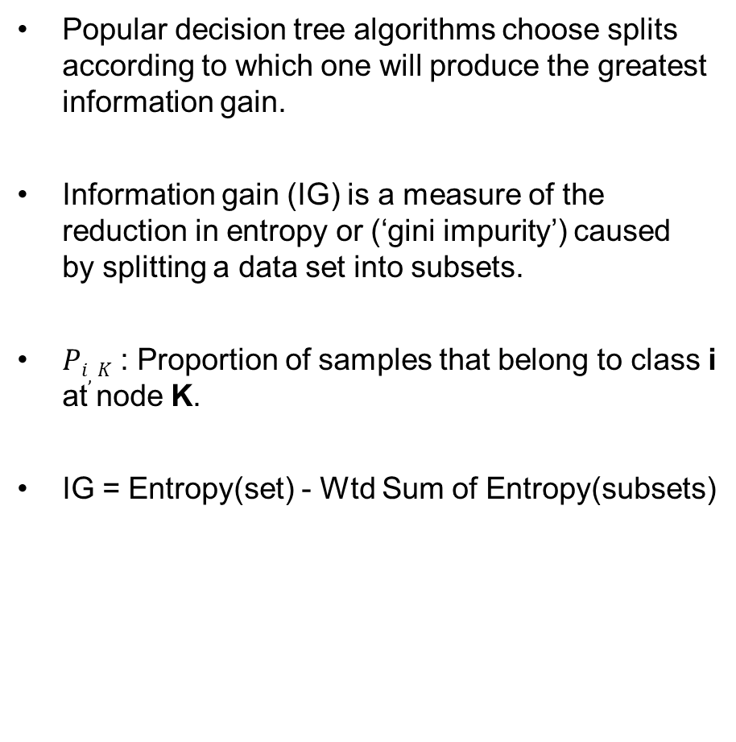
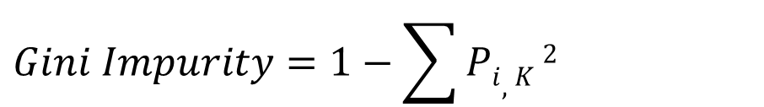
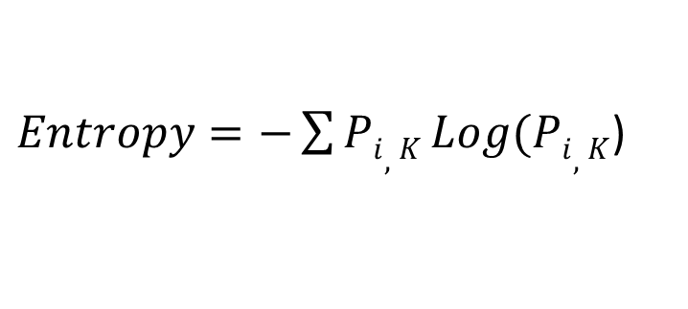
How Are Splits Determined?
Popular decision tree algorithms choose splits according to which one will produce the greatest information gain.
Information gain (IG) is a measure of the reduction in entropy or (‘gini impurity’) caused by splitting a data set into subsets.
$Pi,K$ : Proportion of samples that belong to class i at node K.
IG = Entropy(set) - Wtd Sum of Entropy(subsets)
$Entropy=−\sum{Pi,K}Log(Pi,K$)
$$Gini Impurity=1−\sum{Pi,K}2$$
Notes:
or in other words IG = Impurity(parent) – Wtd sum of impurity (children)
$Pi,K$ : Proportion of samples that belong to class i at node K. (# of instances which belong to class i/ Total # of instances at that node)
Another impurity measure is the classification error: 1- max(p(I,K))

Slide 24



Entropy
Entropy measures the “purity” (i.e., homogeneity) of a group.
Higher Entropy = Higher Information Content
Entropy exists on a scale of 0 to 1.
Perfect purity has an entropy of 0.
Perfect impurity has an entropy of 1.
Perfect Purity
Some Impurity
Perfect Impurity

Slide 25
Advantages & Disadvantages
Advantages:
Simple to understand and interpret.
Requires minimal data preparation.
No feature normalization or scaling required
Able to handle both numerical and categorical data.
Performs well on large datasets.
Disadvantages:
Can create overfitted trees that do not generalize well to new data.
Notes:
Overfitting solution: Regularitzation, by restricting max_depth and other hyper parameters.

Slide 26
Classification: Random Forests
Random Forest is an Ensemble learning method which combines several Decision Trees
Tree1
Tree2
Tree3

Slide 27
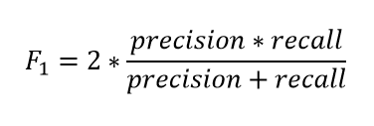
Interpreting Classification Model Output
Confusion Matrix (or Classification matrix or Error Matrix)
 | Predicted Negative | Predicted Positive
Actual Negative | TN | FP
Actual Positive | FN | TP
Overall Accuracy = (TN+TP)/(Total Observations)
Overall Error Rate = (FN + FP)/(Total Observations)
True Positive Rate (TPR) (Sensitivity, Recall) = TP/(FN+TP)
Precision = TP/(TP+FP)
False Negative Rate (FNR ) = FN/(FN+TP) = 1-TPR
True Negative Rate (TNR) (Specificity) = TN/(TN+FP)
False Positive Rate (FPR) = FP/(TN+FP) = 1-TNR
Notes:
Lowering Threshold will increase recall. But will decrease Precision
Increasing Threshold will decrease recall, but will increase precision.

Slide 28
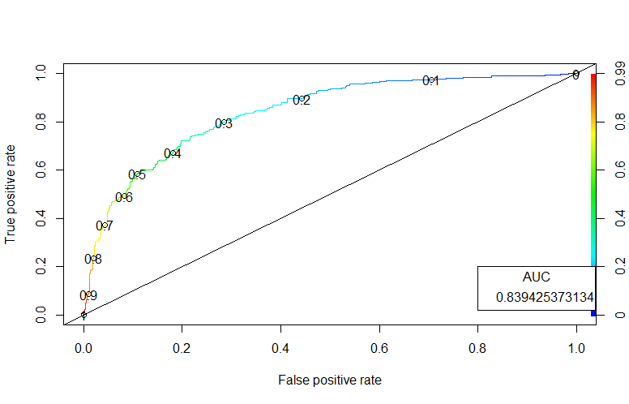
ROCR curves

Slide 29
Best Practices

Slide 30
Data Science, ML - Procedure
Data Collection
Importing, gathering Data or Data Sets
Data Exploration
Visualizations, Scatter Plots, Charts
Correlations, Statistics
Data Preparation
Remove outliers, clean-up
Normalization (do this after the step below)
Remove Missing Values (do this after the step below)
Data Modeling (or Analysis)
Train/Test split
Apply ML Models
Evaluate Models
Different ML-models (using default hyper parameters)
Tune hyper parameters

Slide 31
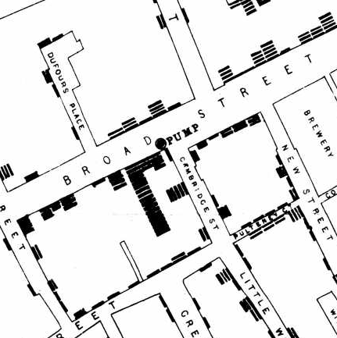
Power of Visualization
Earliest Data Visualization to Solve a Deadly Threat
Terrible outbreak of cholera in London in 1854
Dr. John Snow, set out to track where people died
Identified people died of cholera in a map
Through the power of data visualization he quickly narrowed the source to ‘Broad Street Water Pump’
Notes:
Until Dr. Snow’s discovery, cholera was thought to be spread by miasma (bad smeeling air).

Slide 32
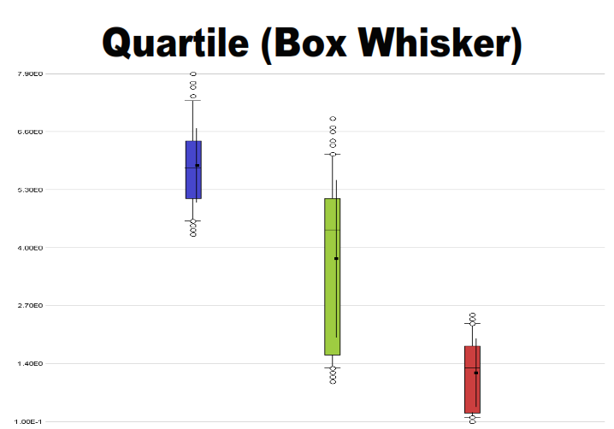
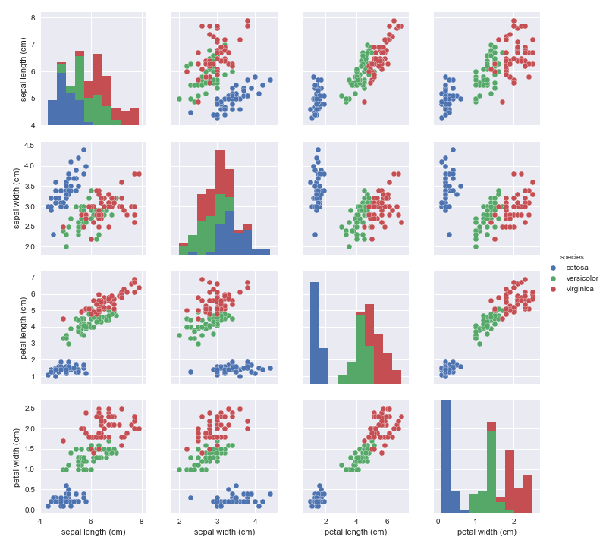
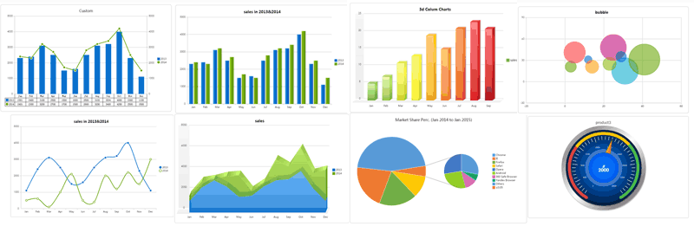
Types of Visualizations
Iris Data Set (Scatter Plots and Histograms)
Different Categories of Charts

Slide 33
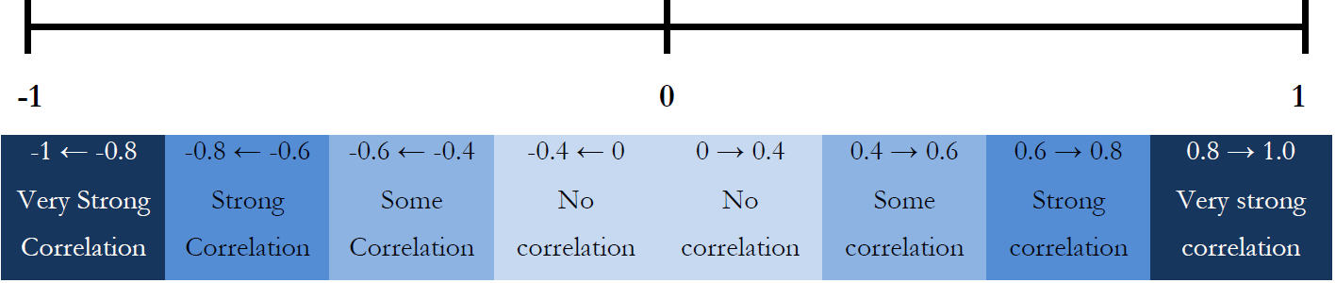
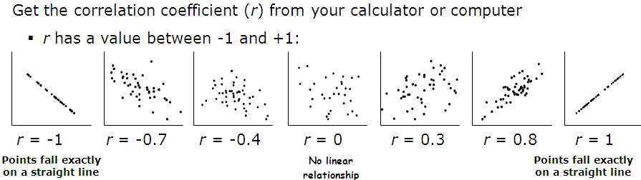
Correlation Analysis
Correlation is a statistical measure of how strong the relationships are between attributes (variables) in a data set.
Notes:
Important for regression analysis

Slide 34
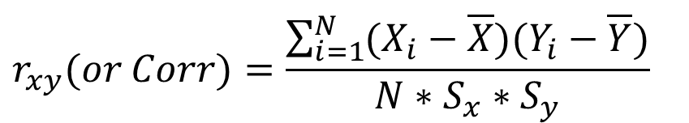
Correlation Interpretation
Correlations tell you about the extent and the direction of a relationship between two attributes
But they do not tell you why the relationship exist.
It is very common to make the mistake of interpreting correlation as causation.
Presence of outliers can skew the measure of correlation.
Correlation do tell a story about the shared variability between attributes
Mathematical process is aimed at telling us only about the strength and the direction of relationship among attributes
How to calculate correlation coefficients
$$r_{xy}(or Corr)=\frac{\sum_{i=1}^{N}{(X_{i}−\overline{X})(Y_{i}−\overline{Y})}}{N∗S_{x}∗S_{y}}$$

Slide 35
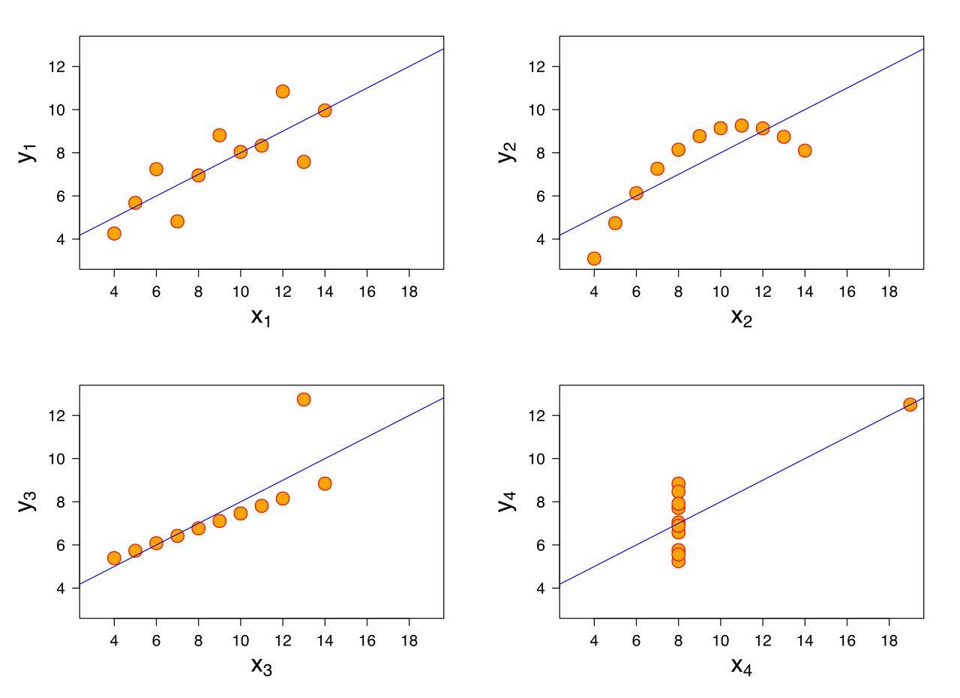
Anscombe’s Quartet
Notes:
Mean of x = 9 (exact)
Sample variance of x = 11 (exact)
Mean of y = 7.50 (to 2 decimal places)
Sample variance of y = 4.125 (plus/minus 0.003)
Correlation between x and y = 0.816 (to 3 decimal places)
Linear regression line y = 3.00 + 0.500x (to 2 and 3 decimal places, respectively)
Coefficient of determination of the linear regression r-sqrd = 0.67 (to 2 decimal places)

Slide 36





Python – Data Science/ML - Ecosystem
Core Python :
Data Structures: Strings, Lists, Dictionaries, Tuples, and Sets
Conditions: if else statements
Automate stuff: For loops, while loop etc..
Wrangle with Data:
Numpy arrays
Pandas Series & DataFrames
Visualize Data: Matplotlib and Seaborn
Machine Learning: Scikit-Learn
Natural Language Processing: NLTK
Seaborn

Slide 37

Scikit-Learn Basics
1. Load Data Sets a) Built-in datsets from sklearn import datasets dir(datasets) – will list the available data sets dset = datasets.load_diabetes() – this is a dictionary which contains actual data, target variable, feature names, and description b). Other datasets can be loaded in as Numpy arrays or data frames pd.read_csv(), pd.read_table(), pd.read_excel() 2. Data Preparation Train/test split from sklearn.model_selection import train_test_split X_train, X_test, y_train, y_test = train_test_split(X,y) Standardization from sklearn.preprocessing import StandardScaler scaler = StandardScaler() scaler.fit(X_train) X_train = scaler.transform(X_train) X_test = scaler.transform(X_test) Polynomial Features from sklearn.preprocessing import PolynomialFeatures poly = PolynomialFeatures() X_train_poly = poly.fit_transform(X_train) X_test_poly = poly.fit_transform(X_test) | 3. Training a model Few ML algorithms from sklearn.cluster import Kmeans from sklearn.linear_model import LinearRegression from sklearn.linear_model import LogisticRegression from sklearn.tree import DecisionTreeClassifier from sklearn.svm import SVC from sklearn.ensemble import RandomForestClassifier Fitting the model & making predictions (Ex: Clustering) kmc = Kmeans() kmc.fit(X) kmc.labels_ Ex: Linear regression lr = LinearRegression() lr.fit(X_train, y_train) y_pred = lr.predict(X_test) – for predictions on test data y_prob = lr.predict_proba(X_test) – for probabilities on test data 4. Evaluation a) Regression from sklearn.metrics import r2_score, mean_squared_error r2_score(y_test,y_pred), mean_squared_error(y_test,y_pred) b) Classification from sklearn.metrics import accuracy_score, recall_score, precision_score, confusion_matrix, roc_auc_score confusion_matrix(y_test,y_pred), accuracy_score(y_test,y_pred) recall_score(y_test,y_pred), precision_score(y_test,y_pred) roc_auc_score(y_test,y_prob)

Slide 38
Thank You ☺
Any questions?

